Slide 1
Stretching Your Budget with Pavement Preservation
March 2021

Slide 2
Presentation Outline
About Your Roads
Pavement Maintenance Strategies
Pavement Maintenance Treatments
Budgeting & Network Approach

Slide 3
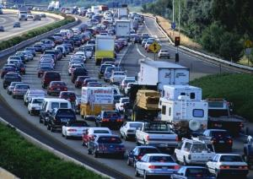


What role do your roads play?
Commuting
  To and from work, school, doctors, stores
Services
  Police, fire, ambulance, mail, trash
Commerce/Shipping
  Merchandise, natural resources, food
Tourism
  Beaches, mountains, skiing, events
Recreational
  Walking, cycling

Slide 4

Your Most Valuable Asset
Integral part of everyday life
Community’s largest financial asset
Can have significant impacts (positive and negative) on
many aspects of municipal activities
Is your network getting the attention it deserves?

Slide 5
Average Road Network Value

Slide 6
Average Road Network by the Numbers
35 miles of paved road ≈ $15.5M replacement value
5 miles of gravel road ≈ $800k replacement value
TOTAL Road Network ≈ $16.3M replacement value
Using an average 20 year lifespan of a road…
  Annual depreciation of the network ≈ $816,000

Slide 7
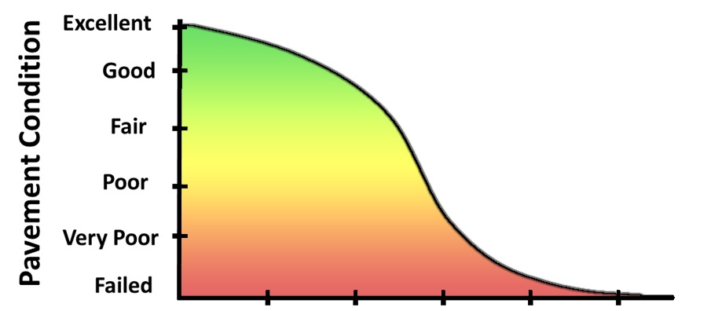

Life of Pavement

Slide 8
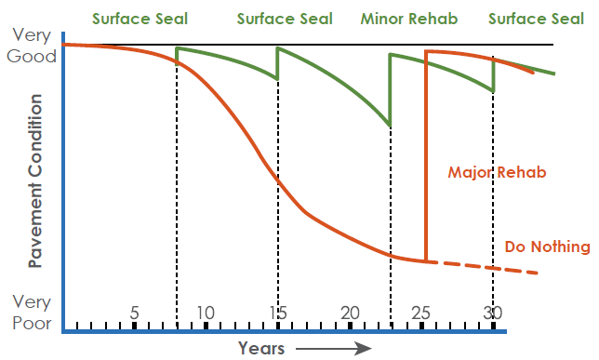
Strategy Comparison
Source: FHWA Every Day Counts

Slide 9
“Worst First”- “Fix it First”
Not Best Fiscal Policy
Fixing the worst roads first means rebuilding, which has the highest cost
Maintenance on other roads is neglected and their conditions worsen
Each year adds more miles to the list of “worst” that need rebuilding
Agencies dig themselves into a deeper financial hole with the “Worst First” strategy

Slide 10
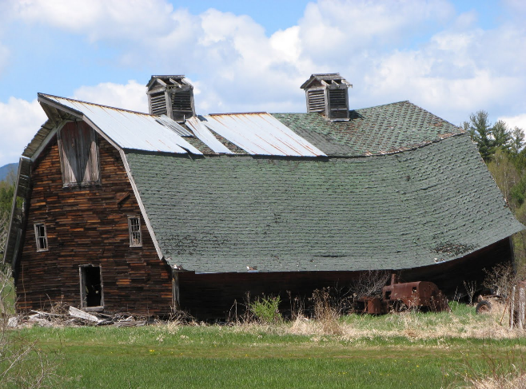
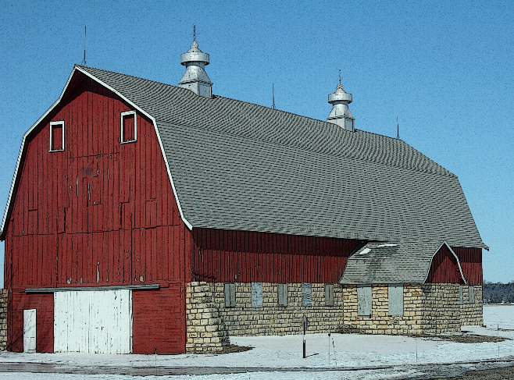
Barns

Slide 11
Pavement Preservation “Definition”
Pavement preservation is a program employing a network level, long-term strategy that enhances pavement performance by using an integrated, cost-effective set of practices that extend pavement life, improve safety and meet motorist expectations.
Source: FHWA-2005

Slide 12
Pavement Preservation “Definition”
Work that is planned and performed to improve or sustain the condition of the transportation facility in a state of good repair.
“Keeping good roads good”
Source: FHWA Guidance on Highway Preservation and Maintenance memo dated February 25, 2016

Slide 13
Philosophy
Pavement Preservation is…
RIGHT TREATMENT
RIGHT PAVEMENT
RIGHT TIME
BE PROACTIVE ‘NOT’ REACTIVE!

Slide 14
Strategies versus Treatments
Reduced $$ and deteriorating conditions should lead to a focus on preservation
Is that happening?
Agencies moving to treatments with lower unit cost to s t r e t c h $$$
Using treatments as Band-Aids is not pavement preservation

Slide 15

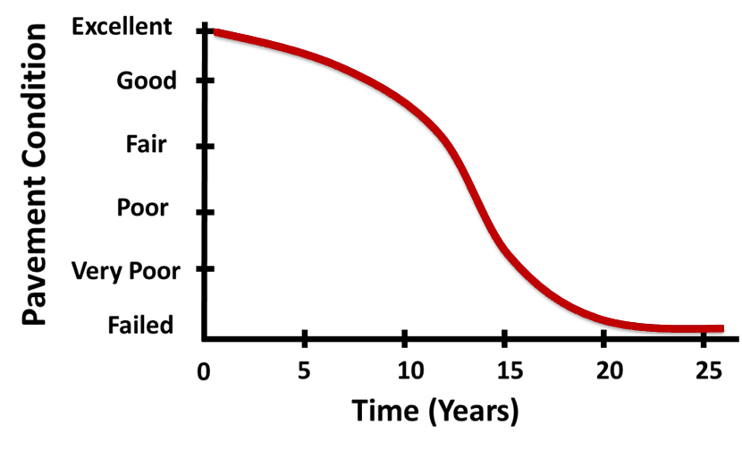
Treatment Timing vs. Cost
Think of treatment cost
as an inverse of existing
pavement condition!

Slide 16
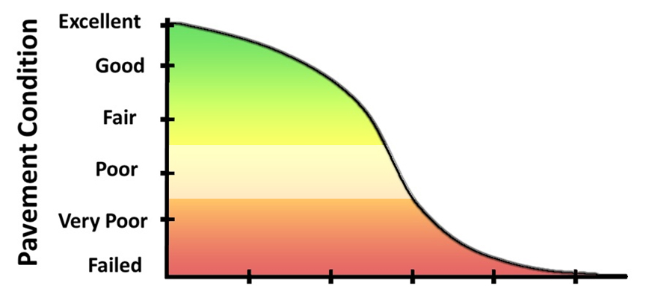
Life of Pavement
$1 of preventive
maintenance here…
Preservation
Eliminates or delays
spending $8 - $10
on rehabilitation here
Rehabilitation

Slide 17
Importance of Good Prep Work
Assure proper drainage, ditching, etc. exists
Trim overhanging brush, branches, and grass
Seal cracks greater than 1/4”
Shim/leveling of rutting/surface irregularities
Address trouble spots (potholes, utility trenches,
spot failures)
Mill joints, intersecting roads, or high spots (if needed)
Adjust utility structures (if needed)
Clean pavement surface of mud, dirt, sand, etc.

Slide 18
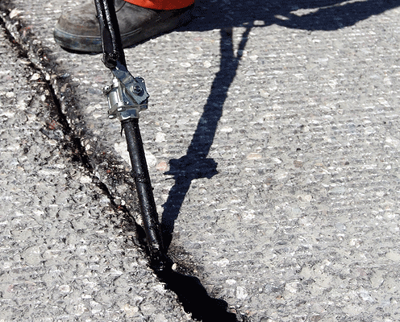
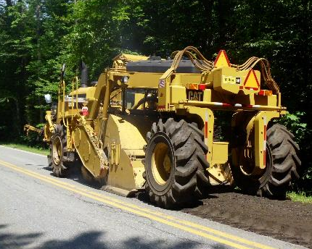
Pavement Maintenance Techniques
Crack Seal
Conventional Chip Seal
Asphalt Rubber SAMs
Microsurfacing
Bonded Wearing Course
(Hot & Cold) In-Place Recycling
Cold Mix Asphalt
HMA Overlays w/ or w/out Milling
Full Depth Reclamation

Slide 19
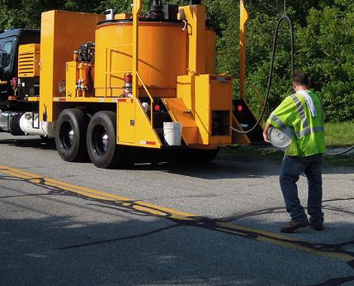
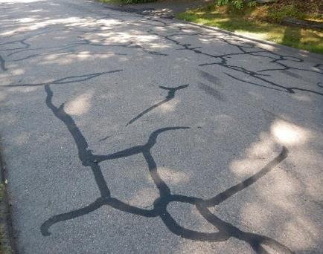
Crack Seal
Existing Road Condition
Low to high volume roads
Sound structural pavement with good drainage
Minor to moderate surface cracking
Often applied before other surface treatments
Process
Routing or sawing, cleaning, and drying existing cracks (as needed)
Application of highly flexible polymer modified asphalt into/over cracks
Benefits
Seals moisture out of existing pavement and base materials
Helps to prevent additional cracking and pavement distress caused by moisture damage

Slide 20
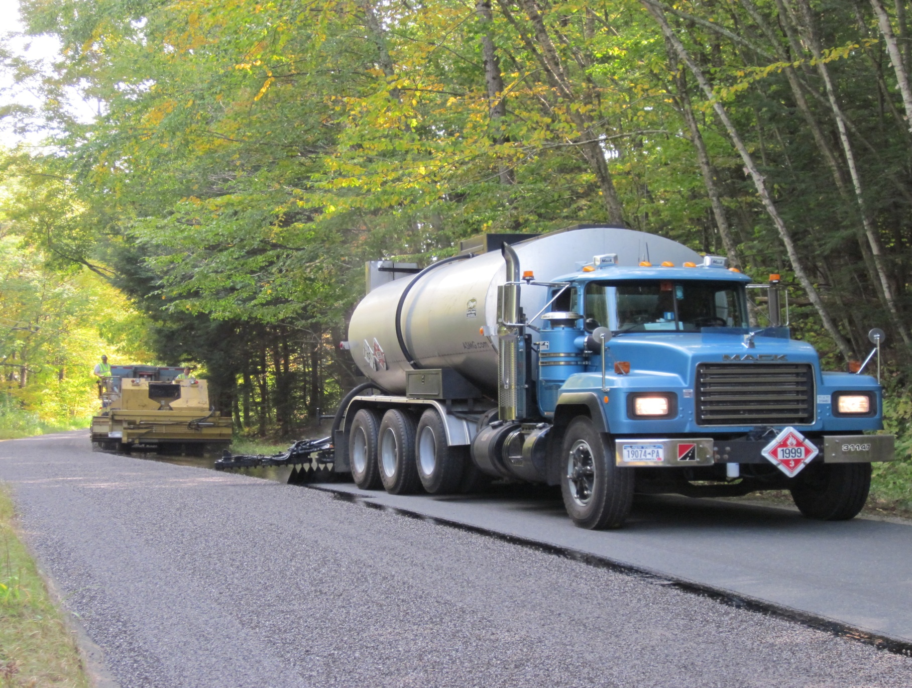
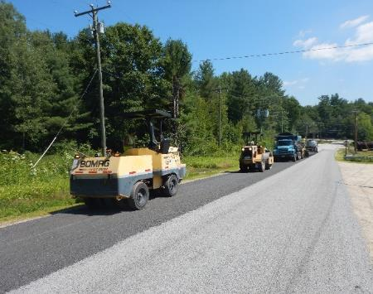
Conventional Chip Seal
Existing Road Condition
Low volume roads
Sound structural pavement with a good profile
Minor to moderate surface distress (cracking, bleeding, raveling, oxidation)
Can be applied in a double application, or covered by a fog seal or microsurfacing
Process
Shim/leveling course and crack sealing (as needed)
Sweeping of surface immediately before application
Spray application of asphalt emulsion (~0.42 gal/SY) followed by a layer of cover aggregate (~20-25 lbs/SY)
Immediately rolled and can be swept in 2-5 days
Benefits
Waterproofs and seals pavement, including small cracks and imperfections
Protects existing surface from traffic wear and improves skid resistance
Quick construction process allows for minimal traffic disruption
Thin profile minimizes impact to driveway and intersecting road aprons

Slide 21
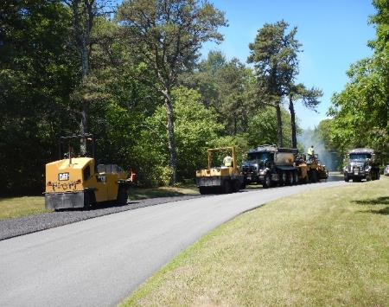
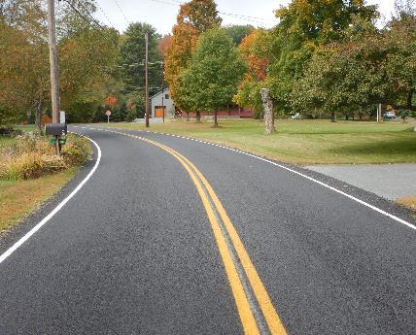
Asphalt-Rubber SAM
Existing Road Condition
Low to medium volume roads
Sound structural pavement with a good profile
Minor to moderate surface distress (cracking, bleeding, raveling, oxidation)
Can be used as an interlayer (SAMI) with HMA overlay
Process
Shim/leveling course and crack sealing (as needed)
Sweeping of surface immediately before application
Spray application of 20% asphalt rubber (~0.60 gal/SY) followed by a layer of heated and treated cover aggregate (~35 lbs/SY)
Immediately rolled and swept leaving no loose aggregate
Benefits
Waterproofs and seals pavement, including small cracks and imperfections
Highly resistant to reflective cracking
Protects existing surface from traffic wear and improves skid resistance
Quick construction process allows for minimal traffic disruption
Thin profile minimizes impact to driveway and intersecting road aprons

Slide 22
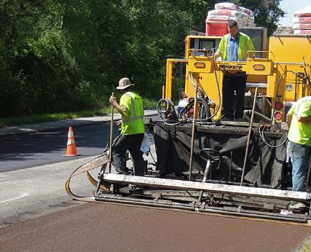
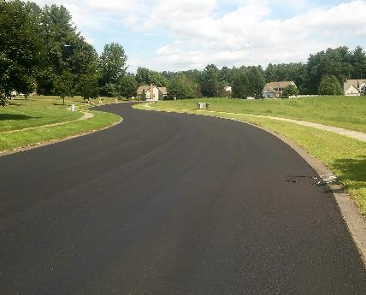
Microsurfacing
Existing Road Condition
Low to high volume roads
Sound structural pavement with a good profile
Minor surface distress (cracking, raveling, oxidation, and minor rutting)
Can be placed over a chip seal to form a cape seal
Process
Crack sealing (as needed)
Sweeping of surface immediately before application
Mixture of asphalt emulsion, fine aggregate, mineral filler, water, and additives applied through a box spreader (18-32 lbs/SY)
Utilizes a polymer modified emulsion and can be applied up to 1½” thick (typically applied at 3/8”)
Benefits
Waterproofs and seals pavement, including small cracks, minor rutting, and surface imperfections
Provides new wearing surface with improved skid resistance
Minimal changes to grade (maintains curb reveal and structures do not need to be adjusted)

Slide 23
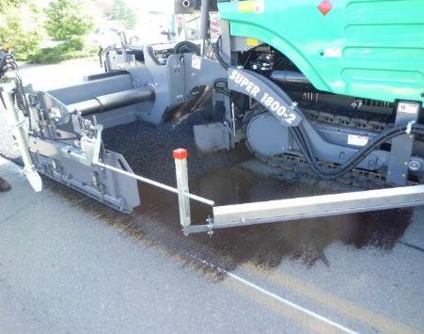
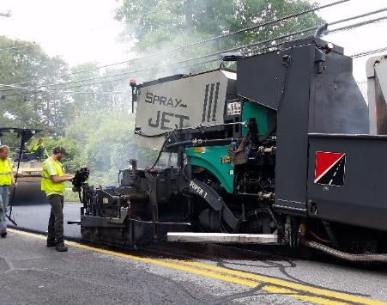
Bonded Wearing Course
Existing Road Condition
Low to high volume roads
Sound structural pavement with a good profile
Minor to moderate surface distress (cracking, raveling, oxidation, and minor rutting)
Process
Shim/leveling course and crack sealing (as needed)
Spray paver application of polymer modified emulsion and ultrathin (5/8” - 3/4”) gap graded HMA overlay (~85 lbs/SY)
Immediate rolling and return to traffic
Benefits
Waterproofs and seals pavement, including small cracks, minor rutting, and surface imperfections
Superior bonding allows for thin application that preserves curb reveals, driveways, and intersecting roads
High skid resistant wearing surface that will not de-laminate
Quick construction and curing process allows for minimal traffic impact

Slide 24
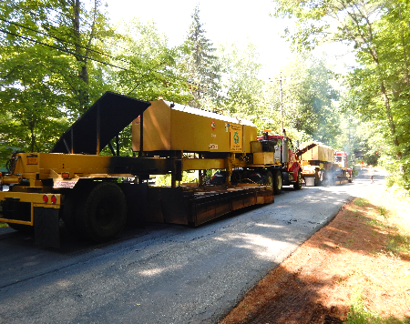
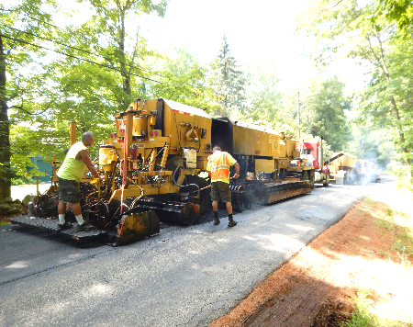
Hot In-Place Recycling
Existing Road Condition
Low to high volume roads
Sound structural pavement base with good drainage
Moderate to severe surface distress (cracking, raveling, oxidation, and minor rutting)
Process
Continuous equipment train heats existing pavement to 250-300°F before scarifying and milling to ¾ - 2”
Material is mixed with rejuvenating asphalt binder and repaved to roadway
Immediate compaction and open to traffic
Must be finished with surface treatment or HMA overlay
Benefits
Restores profile of roadway
Provides improved base course utilizing existing materials

Slide 25
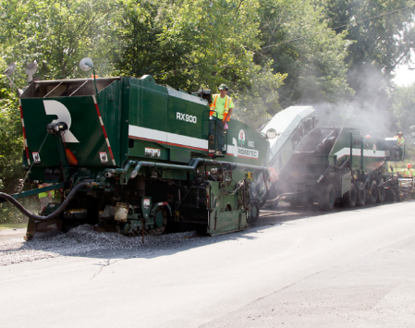
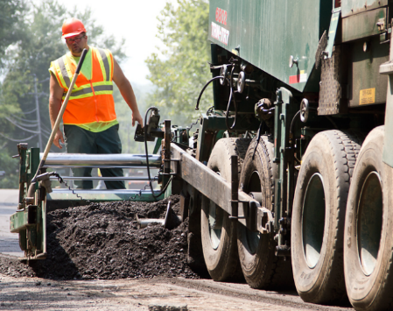
Cold In-Place Recycling
Existing Road Condition
Low to high volume roads
Sound structural pavement base with good drainage
Moderate to severe surface distress (cracking, raveling, oxidation, and minor rutting)
Process
Continuous equipment train that mills, grinds, and resizes 3-5” of pavement (RAP)
Asphalt emulsion or foamed asphalt mixed with RAP onboard and placed back on roadway
Immediate compaction and open to traffic
Must be finished with surface treatment or HMA overlay
Benefits
Restores profile of roadway
Eliminates rutting, cracking, and patch issues in pavement layer
Recycles existing materials in place

Slide 26
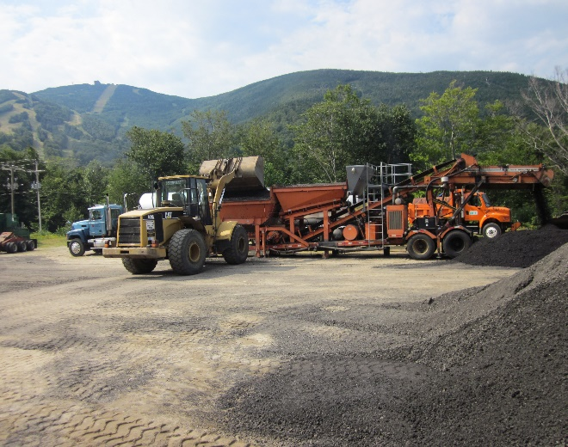
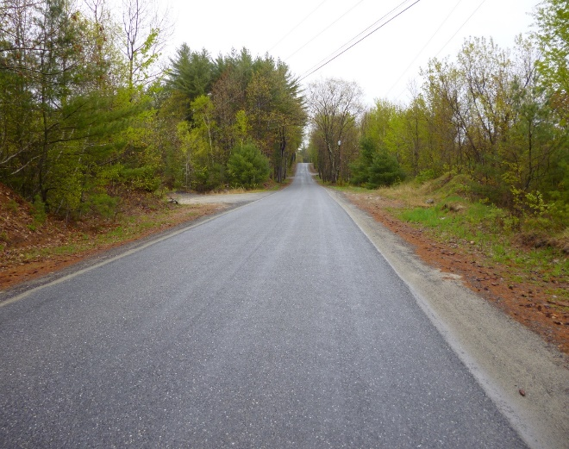
Cold Mix Asphalt
Existing Road Condition
Low volume roads
Minor to moderate surface distress (cracking, raveling, oxidation, and minor rutting)
Process
Cold mix asphalt paving between 2-4 inches in thickness
Immediate compaction and open to traffic
Should be covered with a final wearing surface
Benefits
Cost-effective paving for upgrading non-engineered rural roads
Can be produced at central plant or on-site to minimize transportation and material costs
Flexible but strong pavement materials resistant to rutting, cracking, and moisture damage
Surplus material can be stockpiled and used for patching at a later date

Slide 27
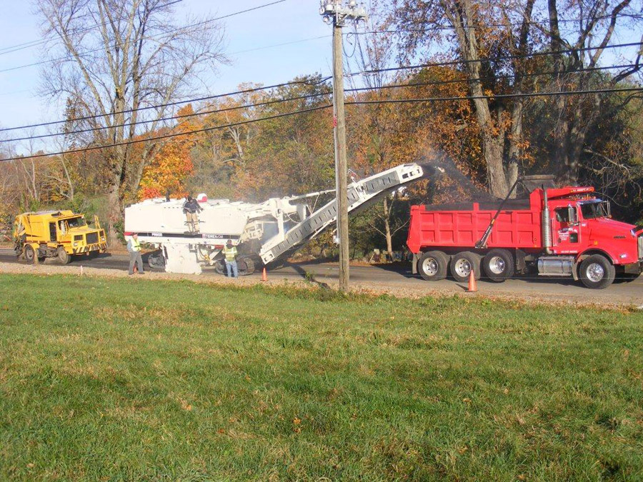
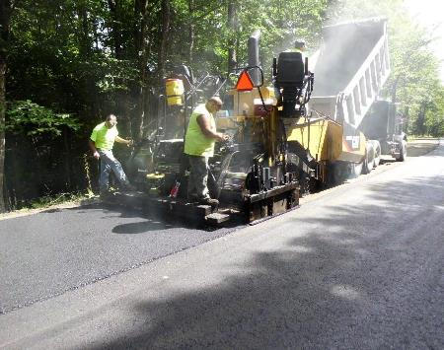
HMA Paving w/ or w/out Milling
Existing Road Condition
Low to high volume roads
Sound structural pavement with a good profile
Minor to moderate surface distress (cracking, raveling, oxidation, and minor rutting)
Process
Milling and/or crack sealing (as needed)
Hot mix asphalt paving (~112 lbs/SY per inch of thickness)
Immediate compaction and open to traffic
Benefits
Waterproofs and seals pavement, including small cracks, minor rutting, and
surface imperfections
Provides new wearing surface with improved rideability

Slide 28
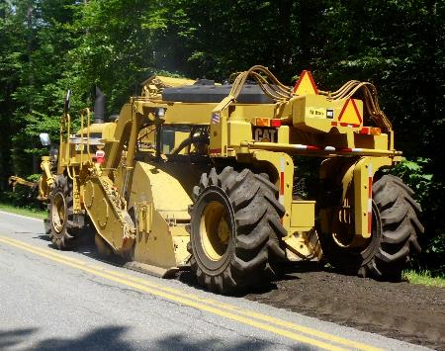
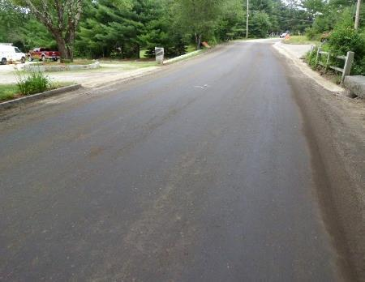
Full Depth Reclamation
Existing Road Condition
Low to high volume roads
Unstable pavement base and poor profile
Moderate to severe distress (cracking, raveling, oxidation, rutting)
Process
Sample and test existing pavement and base materials
Pulverize existing roadway
Grade and roll
Second pass with stabilization (if needed)
Fine grade and compact treated material
Must be finished with HMA, CMA or surface treatment
Benefits
Strengthens the base, adding traffic bearing capacity
Breaks the crack pattern of the road
Creates a uniform base across the road cross-section
Uses existing materials in-place in a true recycling process

Slide 29
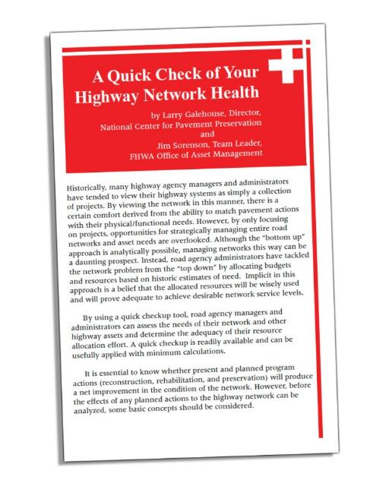
Pavement Network Evaluation
A Quick Check of Your Highway Network Health
  By Larry Galehouse,
  Director, National Center for
  Pavement Preservation
  And Jim Sorenson, Team Leader,
  FHWA Office of Asset Management
  Available at pavementpreservation.org

Slide 30
Network Approach Concept
Every mile of road ages (deteriorates) by
1 year each year (a “mile-year”)
For every mile of road in your network, you must preserve/extend the network life by one mile-year through treatments each year
Example: For an average 25 mile (paved) network, you must gain at least 25 mile-years of life through work each year to maintain the current network condition

Slide 31
Every Treatment Has…
Unit cost
Estimated life extension
(number of years until the road returns to it’s prior condition)
Using these values, we calculate the Equivalent Annual Cost
EAC = Unit Cost / Estimated Life Extension

Slide 32
Estimated Treatment Costs
Surface Seal $0.50 - $1.50 / SY
(Crack Seal, Fog Seal)
Single Seal $1.75 - $3.00 / SY
(Single Chip, Single Micro)
Double / High Performance Seal $3.50 - $6.00 / SY
(Double Chip, Double Micro, Asphalt Rubber SAM)
Combination Seals / Thin Overlays $6.00 - $8.00 / SY
(Cape Seal, Shim & Single Seal, Thin HMA, Bonded Wearing Course)
Shim & Overlay / Mill & Fill $8.00 - $12.00 / SY
In-Place Recycling & Overlay $12.00 - $18.00 / SY
(Hot In-Place Recycling, Cold In-Place Recycling)
Reclaim & Pave $15.00 - $20.00 / SY

Slide 33
Treatment Life Extensions
Treatment | Good Condition (PCI=80) | Fair Condition (PCI=60) | Poor Condition (PCI=40)
Crack Fill / Crack Seal | 1 - 3 | 0 - 2 | 0
Single Seal | 4 - 8 | 3 - 5 | 0 - 3
Double or High Performance Seal | 6 - 12 | 3 - 8 | 2 - 4
Thin Overlay or Combo | 8 - 14 | 4 - 10 | 3 - 6
FDR & HMA | 12 - 18 | 12 - 18 | 12 - 18
Applying treatments at the right time
yields the best return on your investment!

Slide 34
What Does This Mean For YOU???
1 mile of road, 22 feet wide
Comparing 6 treatment options
  Reclaim & Repave
  Cold Mix & Single Seal
  Crack Seal & Overlay
  Shim & Single Seal
  Crack Seal & Single Seal
  Crack Seal

Slide 35
Example Treatment Options
Treatment | Total Cost | Life Extension
Reclaim & Repave | $202,541 | 15
Cold Mix & Single Seal | $130,764 | 10
Crack Seal & Overlay | $87,790 | 8
HMA Shim & Single Seal | $59,013 | 8
Crack Seal & Single Seal | $36,416 | 6
Crack Seal | $5,000 | 3

Slide 36
Rehab Strategy

Slide 37
Rehab & Repair Strategy

Slide 38
Preservation Strategy

Slide 39
Strategy Comparison
Strategy | Miles Treated | Total Cost | Years Gained | Equivalent Annual Cost
Rehabilitation | 2.5 | $506,352 | 38 | $1.10
Repair | 3.5 | $486,478 | 38 | $1.03
Hybrid-Preservation | 4.5 | $381,824 | 39 | $0.80

Slide 40
Summary & Take-aways
Network asset value and the annual depreciation value provide a baseline for funding
A Rehabilitation (and repair to an extent) strategy limits the roadway miles a municipality can maintain annually
A Preservation strategy provides the greatest return on investment and maximizes the miles maintained
Higher funding levels or a Repair & Preserve strategy are needed in order to “maintain” or “improve” the overall network condition

Slide 41

Thank you!
Robert Betsold
Technical Marketing
rbetsold@asmg.com
(413) 887-7384

